Slide 1



P R O J E C T A L E T H I A

Slide 2

SMART INDIA HACKATHON 2020 Finale
Organization Name :Indian Space Research Organization (ISRO)
Problem Statement: Reconstruction of missing data in Satellite Imagery
PS Number : NM391
Team Name : The Ones n Zeros
Team Leader Name : Vignesh Charan Raman
College code : 1-3713389121

Slide 3
Problem Statement
Reconstruction of missing data in Satellite Imagery:
Short Wave Infrared(SWIR) detectors used in satellite imaging cameras suffer from dropouts in pixel and line direction in raw data.
Develop software to reconstruct missing parts of a satellite image so that observers are unable to identify regions that have undergone reconstruction.

Slide 4
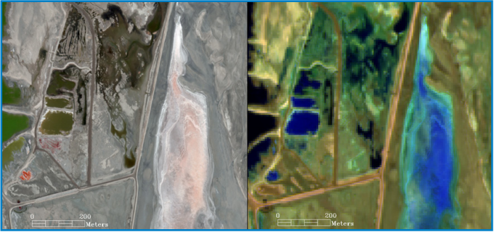
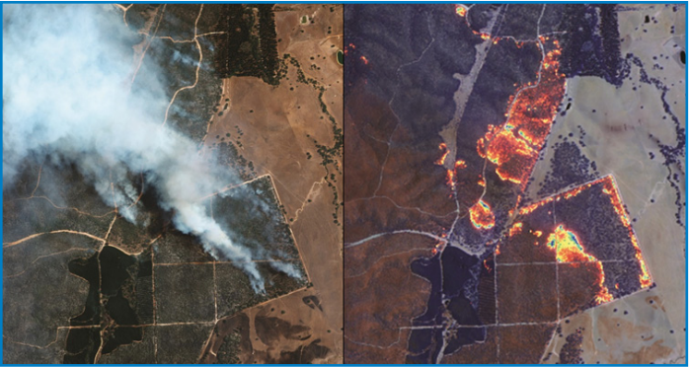
Application of SWIR
Materials identification
Wildfire response
Food security
Mining/Geology
Mineral exploration
Vegetation
Urban planning
Disaster management (oil spill)
Snow and ice discrimination
Soil moisture detection

Slide 5
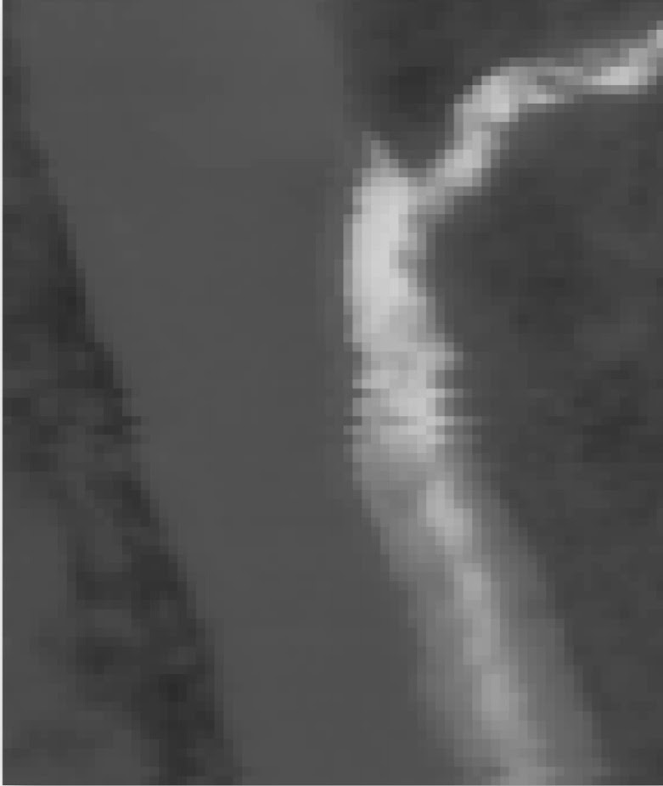
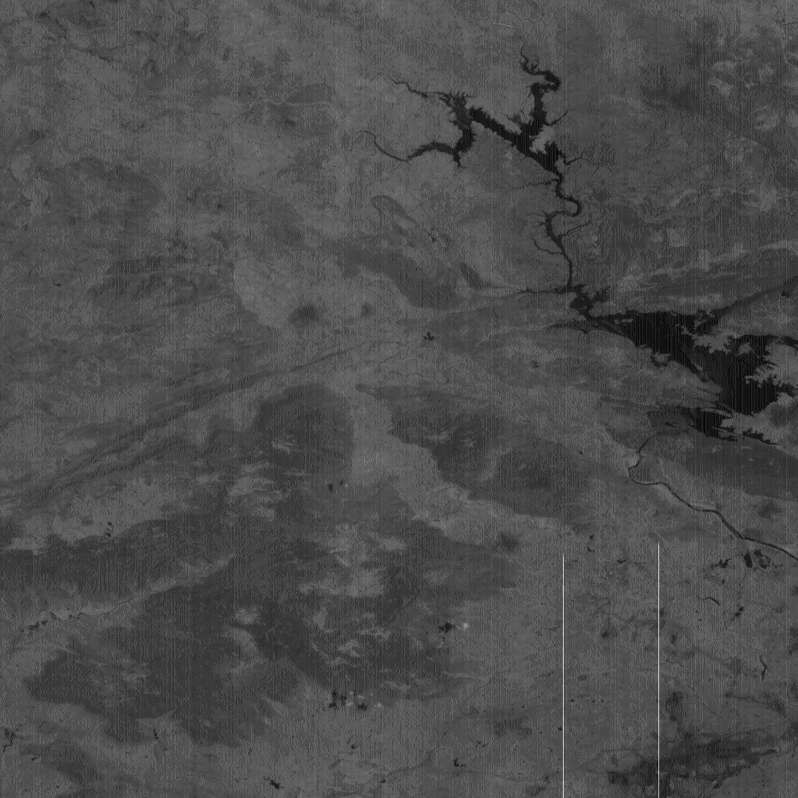
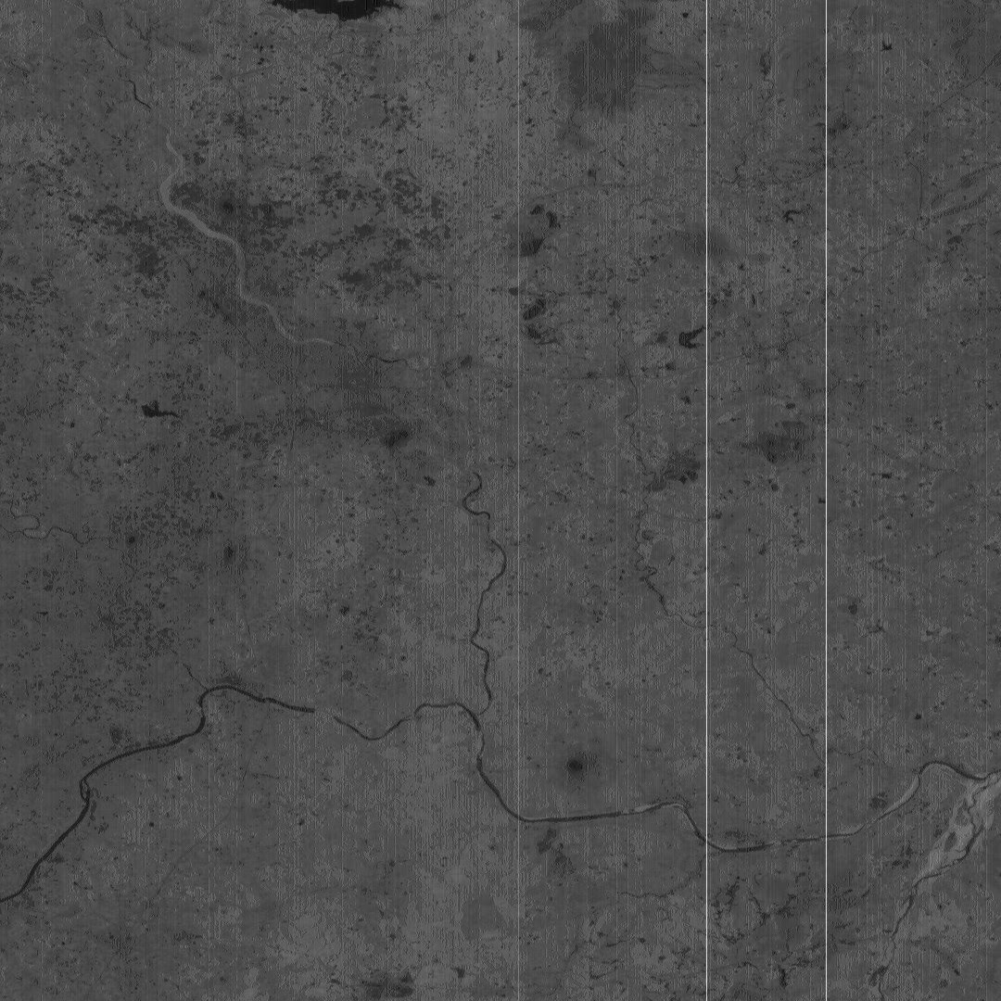
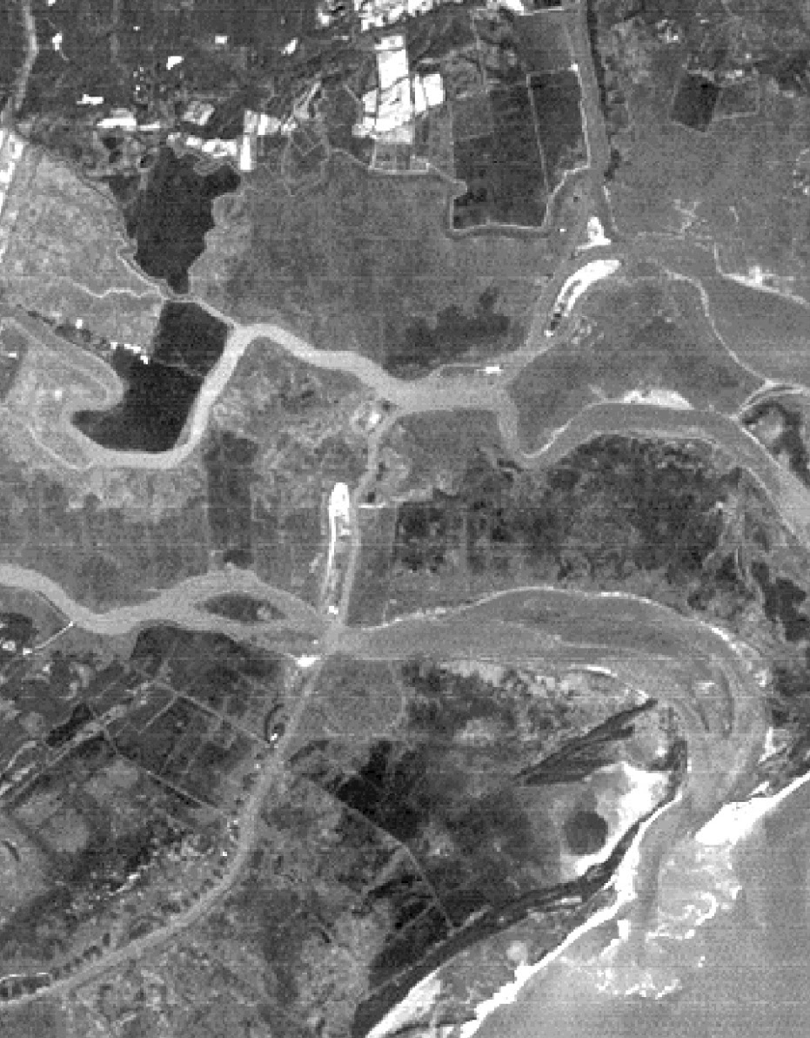
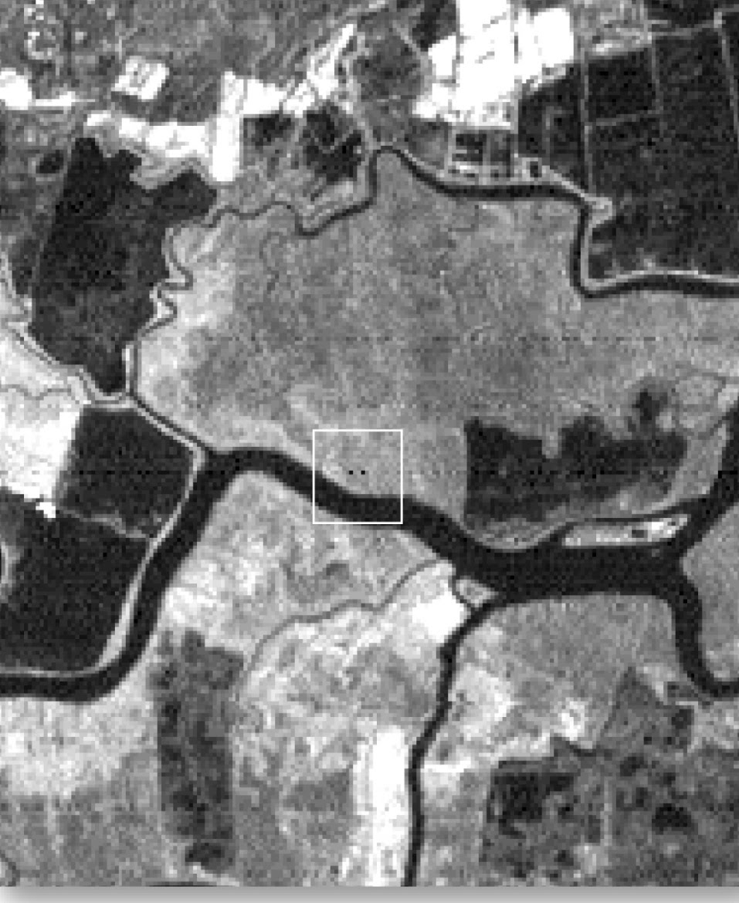
TYPES OF ERRORS
Random bad pixels (shot noise).
Line-start/stop problems.
Line or column drop-outs.
Partial line or column drop-outs.
Line or column striping

Slide 6

Current Solution
Replacement by other Pixels in Vicinity: the brightness value of the missing pixels is replaced by the value of the pixel on immediately preceding or succeeding line.
01
Replacement by Averaging: the brightness value of the missing pixels is calculated by taking the mean of the pixels in its proximity.
02
In essence, simple mathematical operations are used in order to estimate the missing data in terms of numerical values.
03

Slide 7
Proposed Solution
The method we intend to implement relies on the algorithm namely DC-GANs to Reconstruct missing parts of images effectively.
The Training Dataset provided to the Algorithm learns the correlation between the pixels of the image. The nearby pixels are analysed (spatial analysis) and the correlation is applied to fill the incomplete data and the most homologous result which is the final reconstructed image is given as an output.
Since the proposed algorithm uses pristine analysis, the reconstructed Image promises high accuracy with almost no room for error.

Slide 8
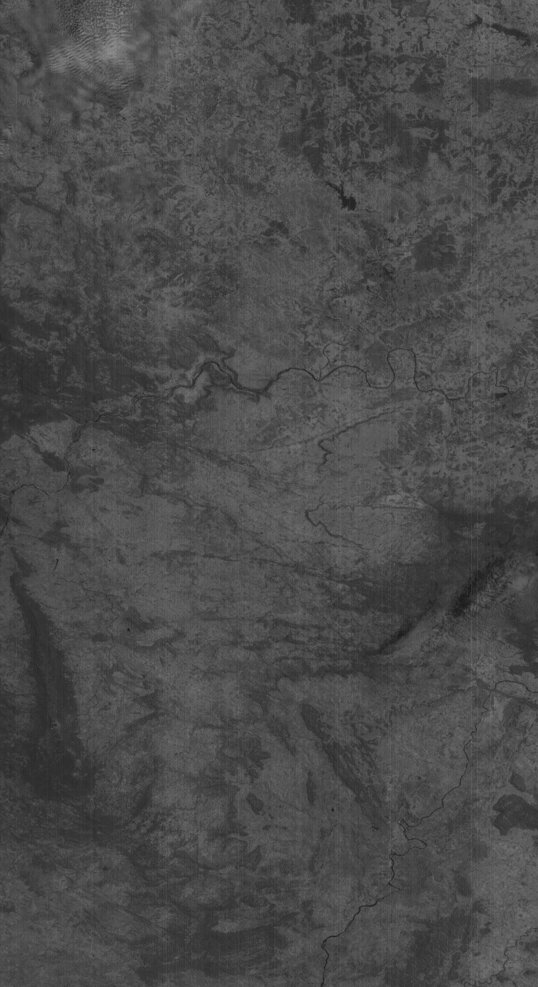
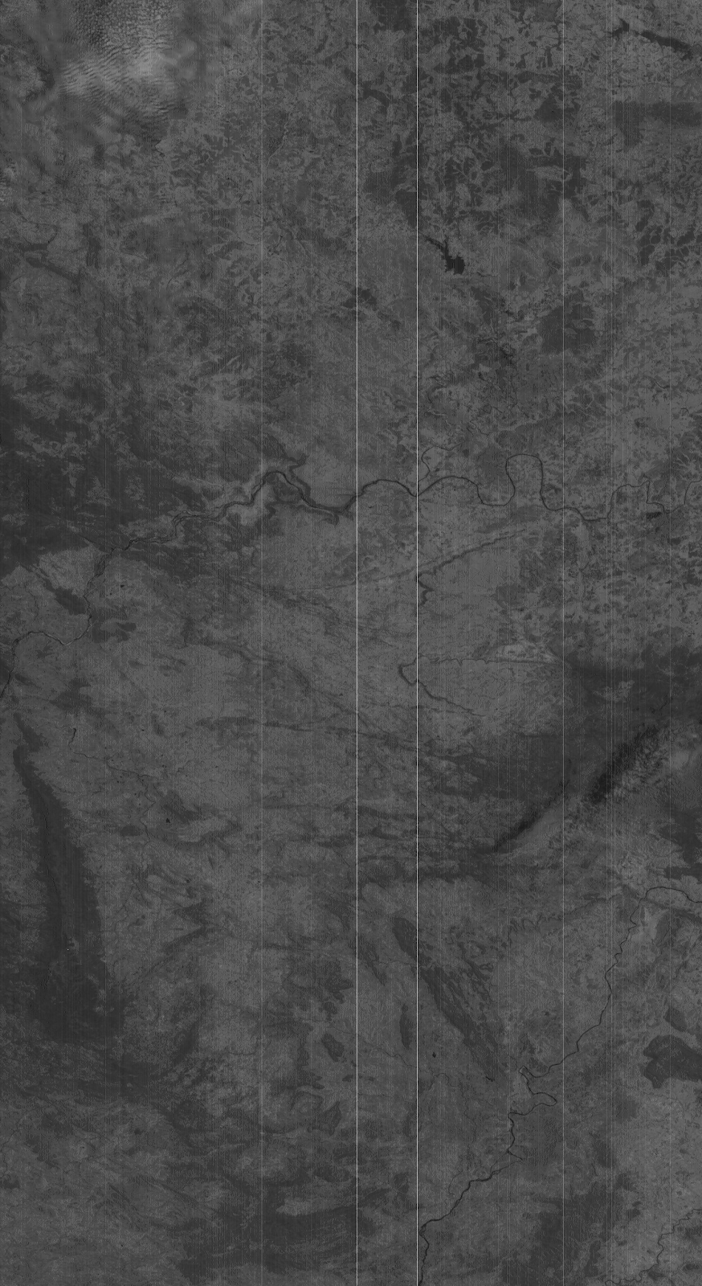
EXAMPLE
OUTPUT
INPUT

Slide 9
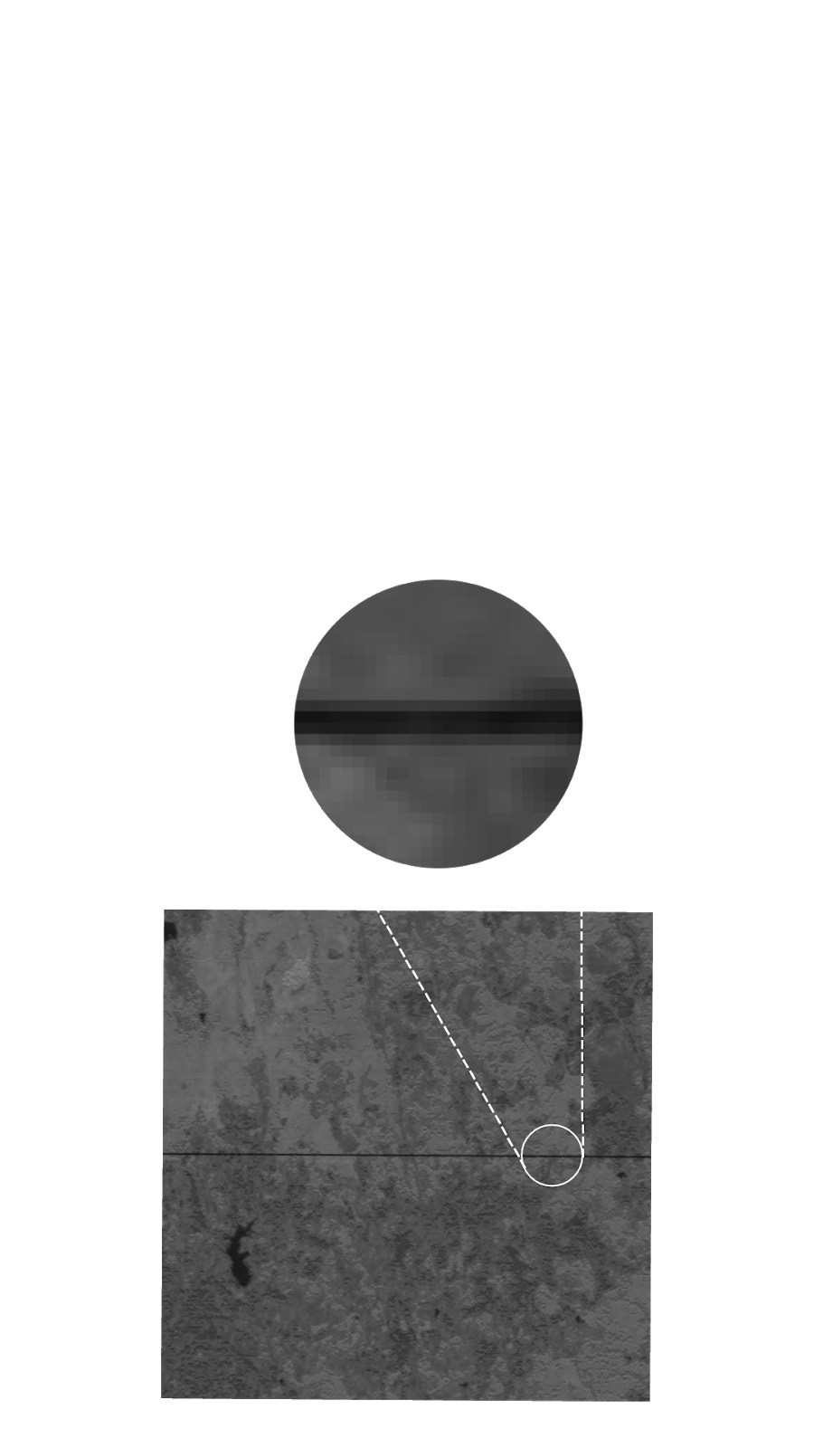
A Spatial Temporal Spectral Convolutional Neural Network analyses the extracted region to form a mathematical relation to derive the intensity of pixels.
A circular span of 50 px is extracted.
Input Image with a Column Dropout

Slide 10
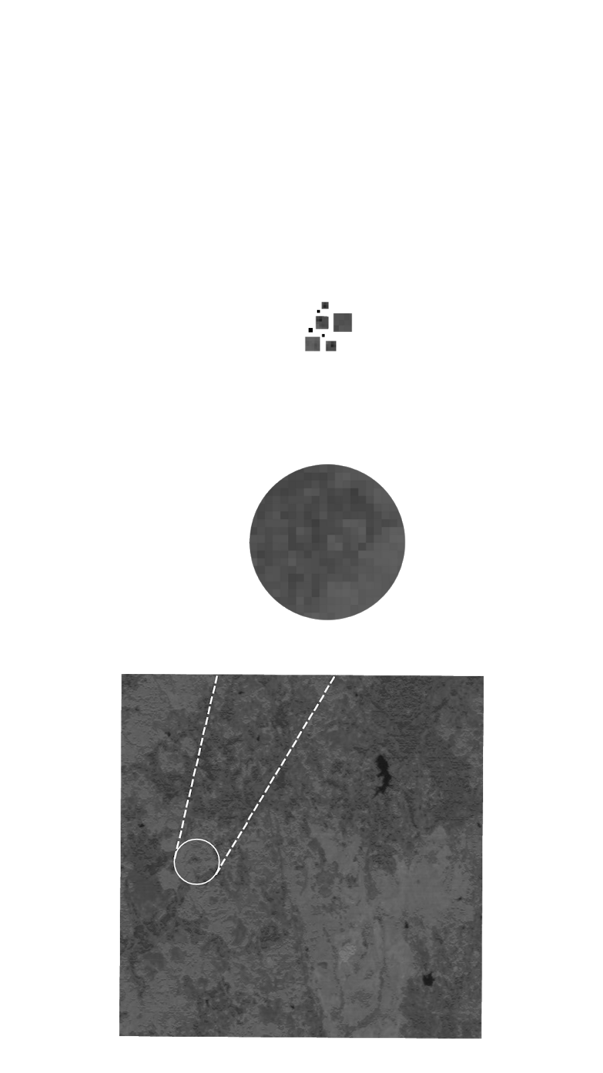
The mathematical relation extracted from the input data is used to predictively generate missing pixels.
The mathematical relation extracted from the input data

Slide 11
Necessity
SWIR Images consists of more details
Bands optimized for the detection of features of greatest interest
Ideal for penetrating smoke, mapping minerals and identifying man-made features
Provide imagery during day and night
Can penetrate thin clouds and haze
Covert illumination
Atmospheric aerosols have minimal effect on SWIR bands
Detect heat via high-heat thermal emissions

Slide 12

THANK YOU

